Slide 1
Introduction to QAM and OFM
Colin P . Chaney

Slide 2
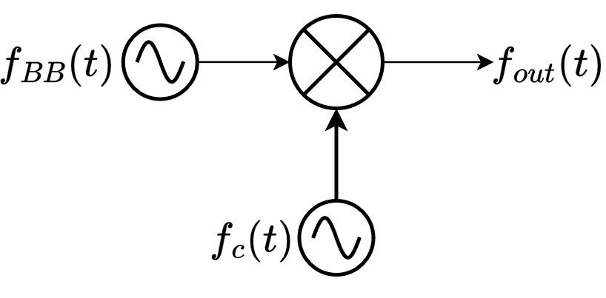



Amplitude Modulation Model
•
: Base-band Signal
(low frequency user input)
•
: Carrier Signal
(high frequency carrier)
Figure 1: Symbol model of amplitude modulation
Equation 1: Mathematical model of amplitude modulation

Slide 3
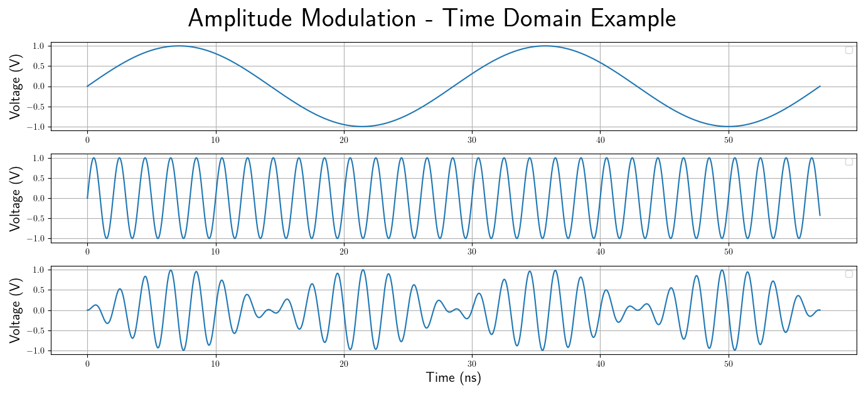
Figure 2: AM Time Domain Example
= 45 MHz Sine Tone
= 500 MHz Sine Tone

